Slide 1
DSC3013 Intro. to Social Media Analytics (Lec. 1)
Hao PENG
Department of Data Science
City University of Hong Kong
https://haoopeng.github.io/

Slide 2
Hao PENG (彭浩)
Assistant Professor
Department of Data Science
College of Computing, CityU
Postdoc: Kellogg School of Management, Northwestern U
PhD: Information Science, Univ. of Michigan
BS: Information Management, Sun Yat-sen Univ.
Research interests:
Computational Social Science, Social Networks, Science of Innovation, Social Media, Management Science, Complex Systems, Network Science, LLM, NLP, AI, Gender, Diversity

Slide 3
About this course
You will learn full pipeline of conducting social media analytics (SMA) in business, economics, politics, marketing, etc.
Data, methods, visualization
Domain applications, ethics, etc.
The main coding environment is Python & R
Instructor: PENG Hao
16F-274, AC3
Office hour: Email or by appointment
TA: LI Wenwen (BS from NYU, MS from Columbia U.)
Research: economics of science funding
Email: wenweli9-c@my.cityu.edu.hk

Slide 4
Key topics
Weeks 1-3: Methodological foundations of SMA
Data foundations, predictive models
Weeks 4-5: NLP & Text analytics
Content analysis, sentiment, emotion, bot, misinformation, etc.
Weeks 6-7: Modeling user behavior
Demographics, psychological traits, online engagement, etc.
Weeks 8-9: Social network analysis
Centrality measures, weak tie, small world, homophily
Social influence, info. diffusion, viral marketing, cascade prediction
Weeks 10-11: Visualization, ethics
NetworkX, Gephi
Limitations of SMA

Slide 5
Tutorials (in-class)
Week 1
Tutorial 1: Setup Python & R
Week 3
Tutorial 2: Predictive analysis
Week 5
Tutorial 3: Descriptive (correlation) analysis
Week 7
Tutorial 4: Bot / fake news detection
Week 9
Tutorial 5: Cascade prediction
Week 11
Tutorial 6: NetworkX
Notes:
Observational studies: descriptive & predictive

Slide 6
Difference with DSC 2005
Method difference
2005: CSS methodologies (observational vs. exp analysis, etc.)
3013: applications of CSS in social media (predictive models)
Domain difference
2005: all social science areas (including, innovation analytics)
3013: all aspects of social media environment
Social media platforms (User behavior)
Social networking sites (Info. diffusion)
Overlapping topics
“Small” Language Models (n-grams, LIWC, LDA, w2v, etc.)
3013: beyond sentiment: content analysis, emotion, personality
User behavior analysis
2005: community level success (online communities, norms)
3013: user/meme attributes (demographics, traits, engagement)
Notes:
Obs design: descriptive (correlation) and predictive (forecasting).
Exp design: real exp vs. causal inference
Word- and Topic-level

Slide 7
Grading
Take-home assignments: 20%
2 homework (individual work) in total
AI tools allowed (disclose how it is used)
Due two weeks after release (submit HTML file)
Paper presentation “assignment”: 10%
Each group (3-4 students) presents one paper (18 groups)
A “hybrid” team formation mechanism (self-selection + random)
Paper selection & presentation order: Week = (Group Num. // 2) + 1
(E.g., Group 2 & 3 on Week 2; Group 18 & 19 on Week 10)
Group project: 20%
The same team as in paper presentation
Class presentation in Week 12 and 13
Final exam: 50%
Close-book written test
No coding task, all conceptual Qs (Similar to 2005 final)
CheatSheet allowed (up to 5 double-sided A4 papers)
Notes:
Self-selection in two days, random assignment this Friday.

Slide 8
Paper presentation (teamwork)
Form your team on Canvas – People – Groups:
Pick one paper from the week your group is presenting
Email me your choice one week before your presentation
2 Groups for each week (Next week: Group 2 & 3; No Group 1)
Submit slides under Canvas - Assignments, after presentation
The pres. (~15 mins) should contain 5 sections:
study context & motivation
research questions
data & methods
key findings & takeaways
implications & limitations & QA
Prepare at least 3 interesting questions to spark discussion among your audiences.
All students need to read the paper before class & actively participate in discussion.

Slide 9
Group project (teamwork)
Proposal due in Week 7 (2%, 1-2 pages)
Study motivation & importance
Dataset & proposed methods
Research design & expectations
Final report due before the final exam date (6%, 8-10 pages)
Submit slides one day before class in Week 12 (12%, 20 mins)
Presentation (Week 12-13; 15 mins) should contain 5 sections:
Study context & motivation
Research questions
Dataset & methods
Key findings & takeaways
Implications & limitations & QA
No free rider: each group member must make meaningful contribution!

Slide 10
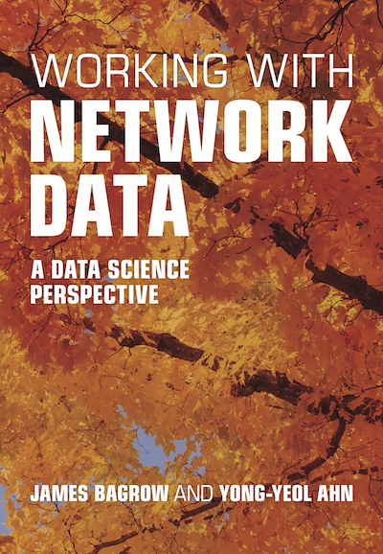


Suggested books
[Natural Language Processing with Python]
[Networks, Crowds, and Markets]
[Working with Network Data]

Slide 11
Late Policy
Late submission is not graded
1 min late is still late
You can still submit after due date (but no grading)
1 penalty-free late submission is allowed
Every student gets one chance
No excuse needed (no need to ask)
Acceptable up to 3 days after due date
Can only apply it to a single assignment
Use it cautiously (for sick, family issues, etc.)

Slide 12
Original work policy
Unless otherwise specified in an assignment, all submitted work must be your own, original work (disclose AI usage).
You may discuss approaches with others on individual assignments, but you may not copy code or other work wholesale.
Any excerpt or reference from the work of others must be clearly identified as a quotation, and a proper citation provided.
Any violation of the Department’s policy on Academic Integrity will result in severe penalties, which might range from:
failing an assignment
failing the course
being expelled from the program

Slide 13
Questions about class logistics?

Slide 14
Agenda for today
What, Why, Where, and How of SMA
Overview of social media platforms
Applications of SMA in various domains
Challenges and opportunities of social media
Emerging technologies in SMA
Setup the coding environment

Slide 15
What is Social Media Analytics (SMA)?
Definition: SMA is the practice of collecting, analyzing, and interpreting data from social media platforms to extract insights on user behavior, trends, opinion, engagement, performance, often to support the decision makings in business, marketing, policy, and research.
Importance: SMA is crucial for businesses, marketers, and researchers as it transforms raw social data into actionable insights, driving strategic decisions and growth.

Slide 16
Primer (why does it matter?)
Social media has fundamentally transformed our daily lives and the very fabric of modern society, revolutionizing how information is created, shared, and consumed.
Today, billions of individuals gravitate towards platforms like X, Instagram, TikTok, RedNote, YouTube, engaging in a digital footprint of scrolling, posting, sharing, and liking.
This digital revolution stands as one of the most significant technological advancements in the modern history, weaving itself so deeply into our human existence.

Slide 17
The evolution of the Internet
Year | Event
1950s | After WWII, the Cold War spawns the need for new ways to communicate more quickly—hence, Arpanet originated for military uses.
1960s | Arpanet became available to researchers around the world.
1970s | Apple and IBM developed personal computers in the late 1970's, which appeal to the masses who can run simple word processing and spreadsheet applications on them.
1980s | TCP/IP was developed as a language for computers to communicate over the Internet. Web 1.0, or the initial version of the World Wide Web, developed and was entirely made up of static, non-interactive Web pages connected by hyperlinks.
1990s | The creation of Web 1.0 led to new Internet-based business models.
What are the differences between Internet and WWW?
Internet -> MTR
WWW -> Shops
Email -> Apartments
Notes:
Internet co-evolves with WWW. WWW is one virtual service running on the Internet, which is a physical infra.
Internet as MTR; WWW as shops (e.g., K11, FestivalWalk). Going through different webpages on the Internet (or surfing the Internet) is like visiting different shops via the MTR.
Email is another service running on Internet. Think of it as apartments: you can also build apartments and travel through them via the MTR.

Slide 18
The evolution of WWW
Feature | Web 1.0 | Web 2.0 | Web 3.0 | Web 4.0
Definition | The "read-only" web. | The "participatory" or "social" web. | The "semantic" / "data" web. | The "symbiotic" web.
Content Creation | Static content created by webmasters. | Dynamic content and user-generated content. | Content linked across platforms, understandable by machines. | AI-generated content, highly personalized and anticipatory.
User Interaction | Limited to reading. | Interactive, with users contributing content and engaging with each other. | Users and machines interact seamlessly, with intelligent search and data integration. | Deeply immersive experiences with AR, VR, and AI enabling natural interactions.
Technologies | HTML, CSS. | AJAX, RSS, Web APIs. | RDF, OWL, SPARQL, Semantic Web technologies. | AI, IoT, blockchain, advanced encryption.
Connectivity | Low. Web pages are mostly isolated. | High. Social media and wikis link people and content. | Very high. Data from multiple sources is connected. | Ubiquitous. Everything is connected, often in real-time.
Data Flow | One-way. | Two-way, with feedback loops. | Multi-directional, context-aware. | Autonomous, predictive.
Privacy and Security | Basic. | Increased focus due to social nature. | Significant concern, with emphasis on standards and protocols. | Critical, with advanced solutions required for safety and ethics.

Slide 19
Understanding social media
Social media is built on the Web 2.0 philosophy, that is, to give more control to the user over the content. It can be defined as an easy-to-use Internet-based platform that provides users with opportunities to create and exchange content in a one-to-one, one-to-many, and many-to-many context.
Key features of Web 2.0
Interactivity and Participation
Everyone can be a producer
Collaboration & Crowdsourcing
Rich User Experiences
Notes:
You may not realize this if you always interact with SM platforms via smart phone apps.
But they all have web-based interfaces (Fb, X, YouTube, Whats up).

Slide 20
History of social media
Year(s) | Description
1990s: | The Internet Goes Public
1991 | The World Wide Web goes live to the public, transforming the internet from a scientific and academic tool into a comprehensive network accessible to the masses.
1994 | GeoCities, a web hosting service, allows users to create their own websites, grouping them into "neighborhoods" based on content themes, resembling early social networking.
1997 | SixDegrees.com launches as one of the first recognizable social networking sites, enabling users to create profiles and friend other users.
2000s: | Social Networking Expansion
2002 | Friendster is launched, aimed at creating a safer, more realistic online community environment, influencing future social networking sites.
2003 | LinkedIn goes live, offering a networking solution for business professionals, while MySpace quickly becomes the most popular social network in the U.S.
2004 | Facebook launches, initially restricted to Harvard students before expanding to other universities and eventually the public in 2006.
2005 | YouTube is created, revolutionizing online video sharing and consumption.
2006 | X launches, introducing a microblogging platform that limits posts to 140 characters, later expanded to 280.
2007 | The introduction of iPhone marks a significant shift toward mobile internet use, greatly influencing social media accessibility and design.
2010s: | The Mobile and Multimedia Era
2010 | Instagram launches, focusing on mobile photo and later video sharing, quickly becoming one of the most popular social platforms.
2011 | Snapchat is released, introducing ephemeral content and multimedia messaging, popularizing the concept of stories.
2012 | Facebook acquires Instagram, further consolidating its presence in the social media sphere.
2013-2014 | The rise of messaging apps like WhatsApp and Telegram, emphasizing privacy and encryption, diversifies the social media landscape.
2016 | TikTok launches internationally, bringing short-form video content to the forefront of social media trends.
2020s: | Evolution and New Horizons
2020-2021 | The COVID-19 pandemic leads to unprecedented growth in social media use, as individuals and businesses rely more heavily on digital platforms for communication, entertainment, and commerce.
2022-2026 | Augmented reality (AR) and virtual reality (VR) integrations in social media platforms enhance user engagement, paving the way for more immersive social experiences. DeepFake. AIGC videos.
Notes:
Stage 0 – Internet development (blogs)
Stage 1: Web 1.0 version (Friendster and MySpace)
Video-blogging, micro-blogging

Slide 21
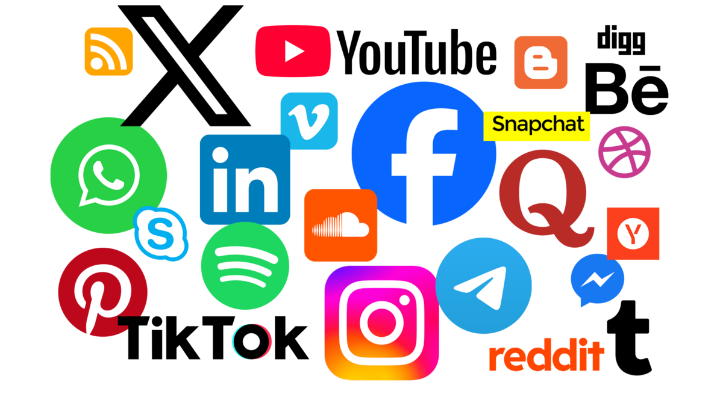
Characteristics of social media
User-Generated Content (UGC)
Connectivity and Interactivity
Personalization & Privacy
Real-Time Communication
Multimedia Content
Accessibility (Web & App)
Notes:
Or even Desktop
Who uses Whats up on Desktop?

Slide 22
Major social media platforms
Top platforms by user base in 2025
Facebook, YouTube, Instagram, WeChat, TikTok, LinkedIn, X, Reddit
Each has > 500 million monthly active users (MAU)
Owned mostly by Tech companies
Meta, Google, ByteDance, Microsoft, Tencent
Notes:
Which one belongs to Google? Microsoft?

Slide 23
Types of social media platforms
Social networking sites
Facebook, Twitter (X), Weibo, WeChat
Media sharing (blogging)
YouTube, Instagram, TikTok, RedNote
Content communities
Discussion forum (Reddit, Douban, Flickr)
Customer review (Yelp, DianPing, TripAdvisor)
Community Q&A (Quora, Stack Overflow, Zhihu)
Online collaborative platforms
Wikipedia, Github, Overleaf
Purpose-build platforms
Dating apps, LinkedIn, Ebay, Airbnb, etc.
Notes:
What dating apps do you use in HK?

Slide 24
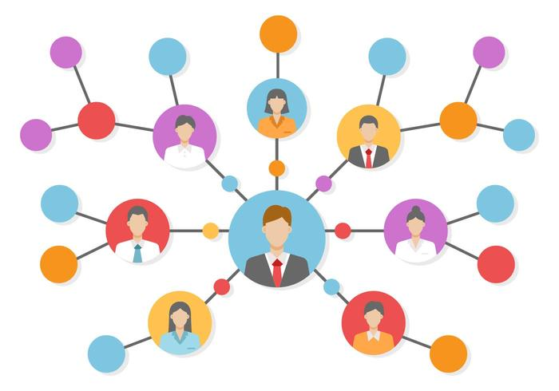
Social networking sites
Network is the key
Node: user
Multiple types of users
organization vs. individual, verified vs. non-verified
Attributes of users
gender, location, age, occupation, interests, joined date
Any others?
Notes:
View history, bio, profile photo

Slide 25
Social networking sites
Edge: relations between users
Follower
Mention
Reply
Repost
Like
Comment
Attributes of edges?
Frequency, Time, Strength, Direction
Publicly hosted Twitter datasets:
https://github.com/shaypal5/awesome-twitter-data

Slide 26
Social networking sites
What’s unique about it?
Full of UGC, real-time information flow
Algorithmic feeds, instant messaging, and multimedia sharing
Complex user interactions and dynamics
Platform usage trends since 2024
Short-form video dominates (e.g., RedNote)
E-commerce integration growing (e.g., FB marketplace)
User demographics
Millennials: Facebook, LinkedIn
Gen Z: TikTok, Instagram

Slide 27

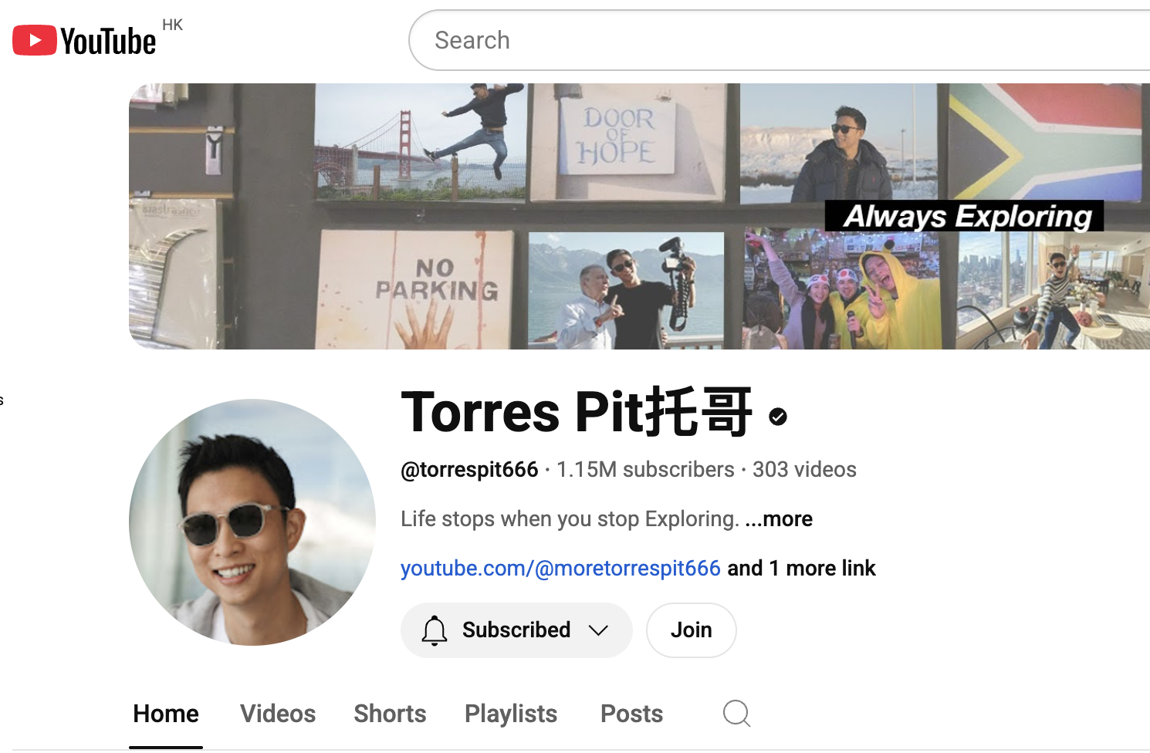
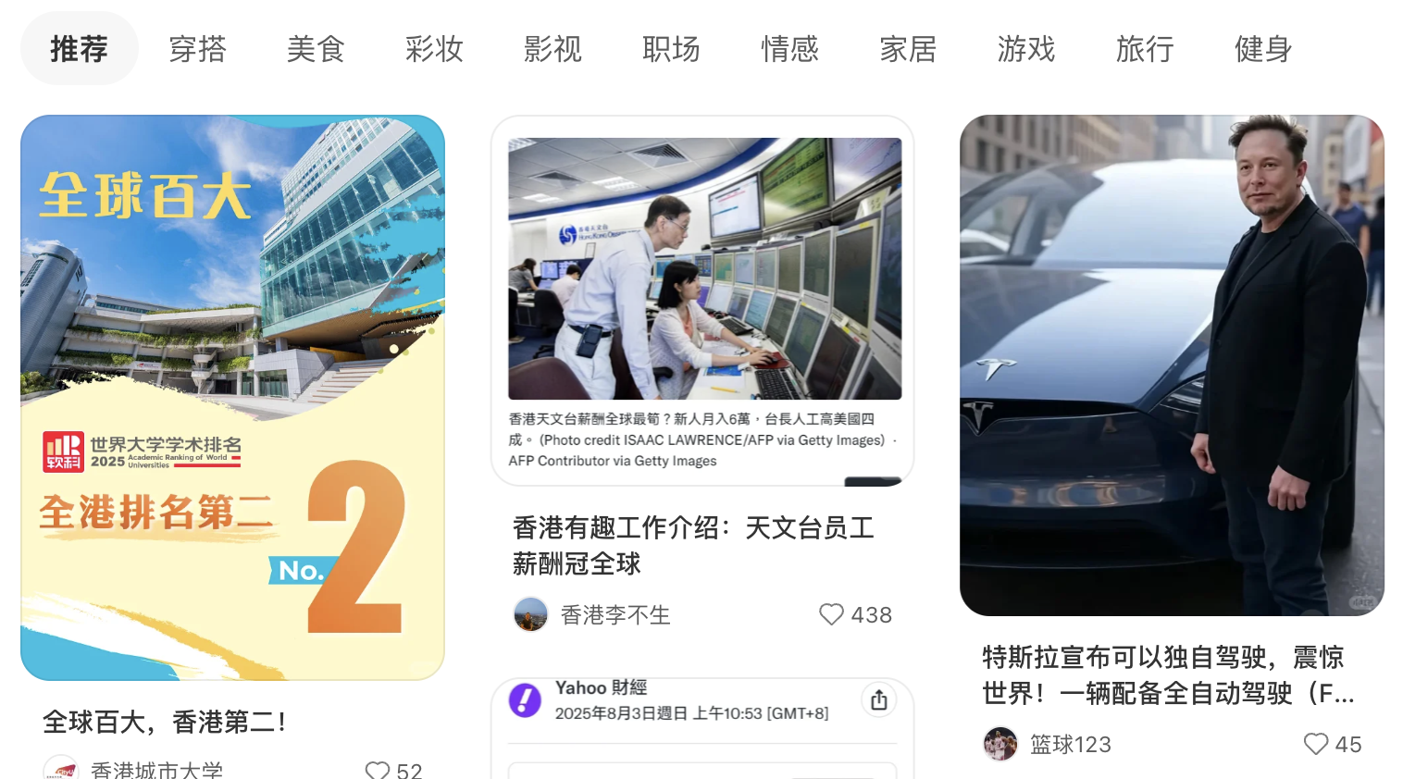
Media sharing sites
Media is more important than social interactions
Mostly for business and marketing purposes
Most users are un-verified / anonymized

Slide 28
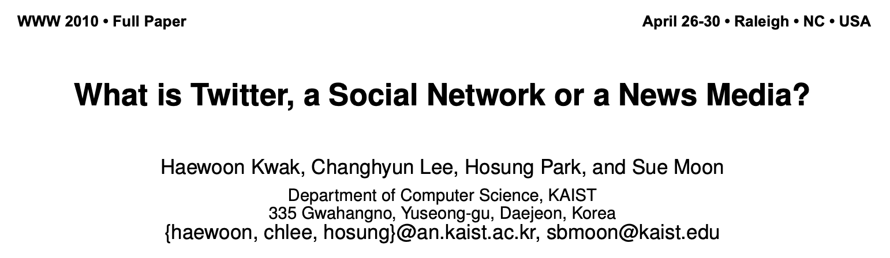
One paper from Week 2

Slide 29

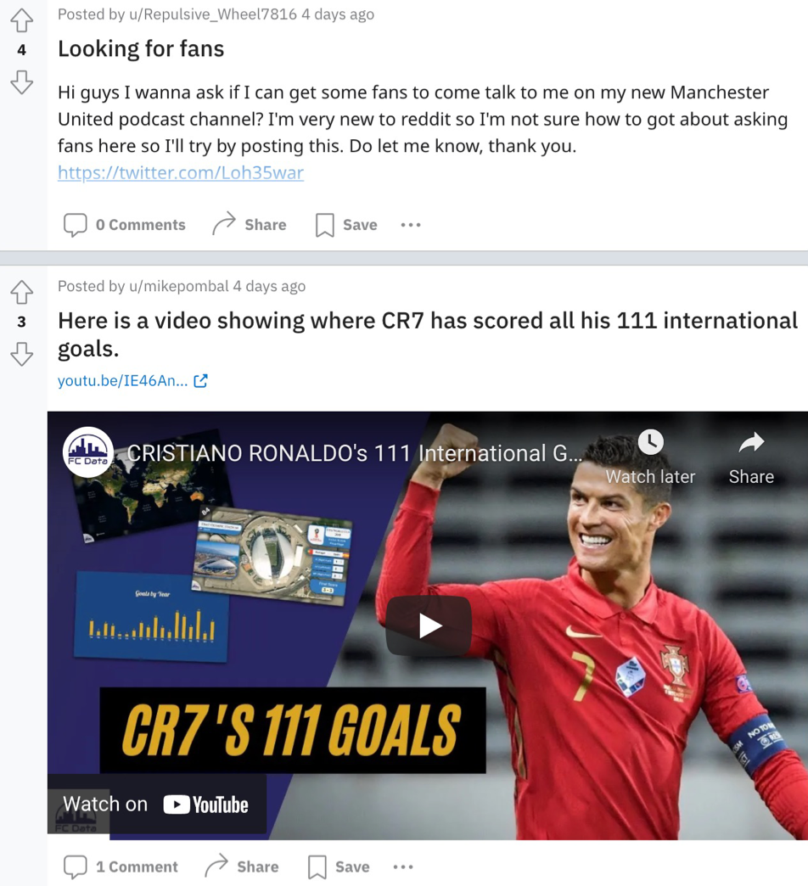
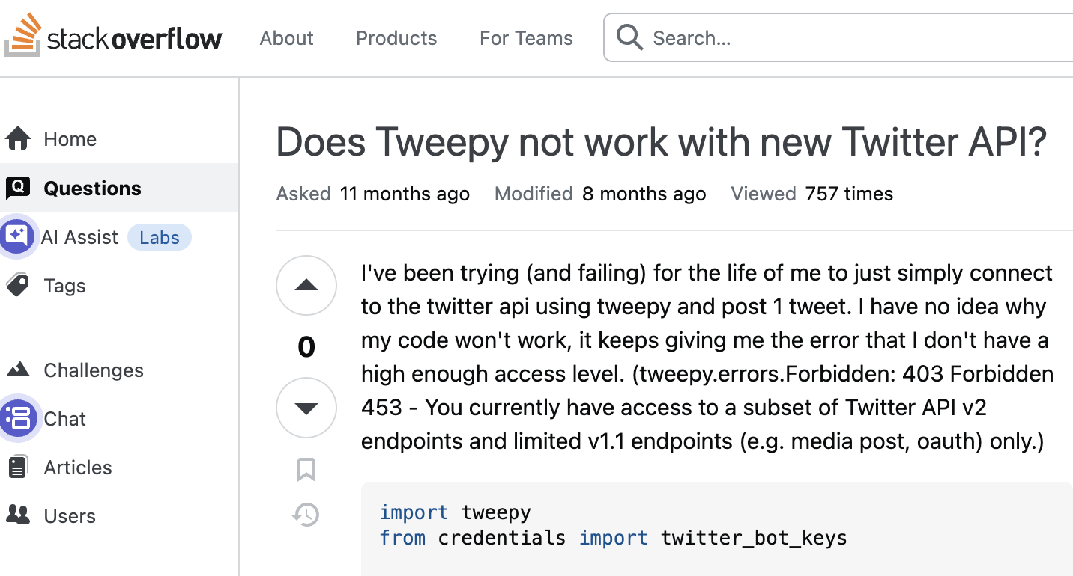
Content communities
They are communities organized based on common interest
Discussion forum (organized by topics)
Online review sites (restaurants, hotels, travel, movies)
Q&A sites (up vote answers, share knowledge/skills)
Far fewer interactions, but very useful resource-wise

Slide 30
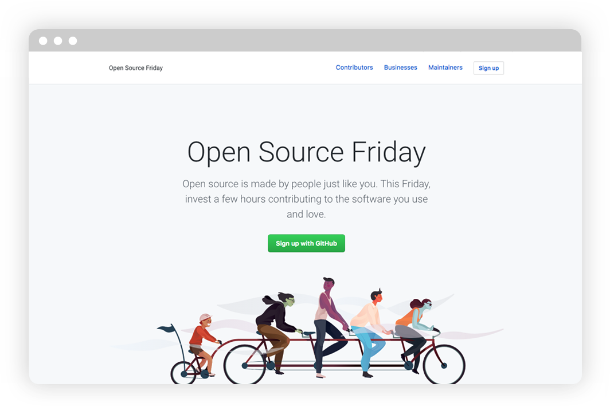

Online collaborative platforms
Crowdsourcing, crowd wisdom, team collaboration
Many are used for non-commercial purposes

Slide 31
Why should we study SMA?
Business insights: Companies leverage social media analytics to understand consumer preferences, optimize marketing campaigns, and enhance brand engagement.
Advancing research: In computational social science, social media data enables researchers to study topics like polarization, cultural trends, or network dynamics at scale, often in real time, complementing traditional methods like surveys.
Informing public policy: Governments and non-profit organizations use social media data and analytics to gauge public sentiment, monitor misinformation, predict social unrest, and mobilize political protests.
Personal development: learn technical skills (e.g., NLP tools, network analysis, machine learning) and critical thinking, which are transferable across careers in data science including academia and industry positions.
Where can we apply SMA to inform decision-making and drive economic value?
Notes:
Double-edged swords
Side effects outweight its benefit we gain

Slide 32
SMA in business and economics
Consumer behavior and spending prediction
Box office revenue, retail sales, market share, etc.
Stock market prediction
Price movement, trading volumes, market index, etc.
Macroeconomic indicators
Unemployment rates, GDP growth, consumer confidence, etc.
Socioeconomic status and income prediction
Education, age, gender, race, marital status, income level, etc.
More…
Notes:
Once a platform knows more info about you, they can deliver better marketing campaign and content to you.

Slide 33
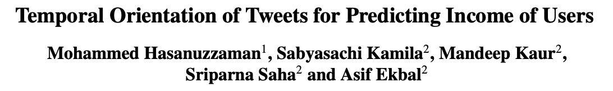
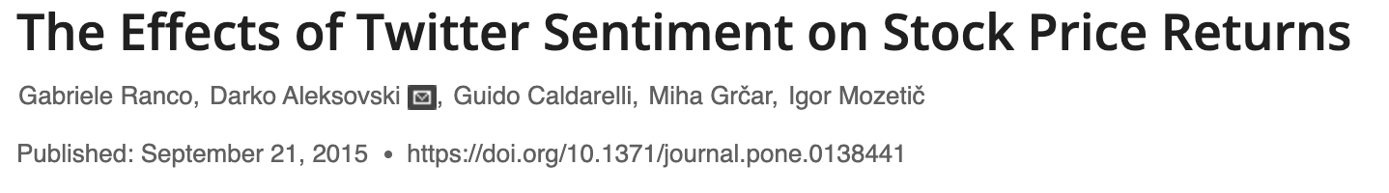
Business applications
Twitter users’ “future” words usage predicts income level
Sentiment expressed in tweets correlates with abnormal stock returns during the peaks of Tweets volume.

Slide 34
SMA in politics / policy
Political campaign
Voter sentiment analysis
Predict offline activities (protest, shooting, etc.)
US presidential election
Predict supporting rate via social data
Estimate temporal and geographical trends
Observatory of online social movement (OSM)
#MeToo
#BLM
#HongKongProtest
……
Notes:
Political hashtag cloud.
Election poll graphic.

Slide 35
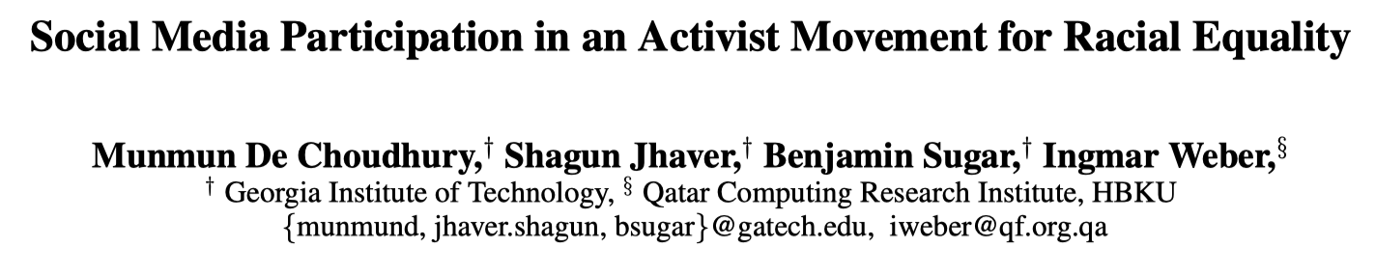
BLM OSM predicts offline events

Slide 36
BLM OSM predicts offline events
BLM: a social movement of police violence against Blacks
Research Qs:
Are there geographical variations in social media language used?
Can engagement and linguistic attributes predict offline events?
Online and offline datasets:
Collected ~30M tweets by 6M users with #blm related hashtags
Police shooting data: https://fatalencounters.org/our-visualizations/
Protest data: https://elephrame.com/charts/BLM
Methodology:
Use NLP models (LIWC) to calculate linguistic features of online Tweets
Leverage predictive/reg models to predict the volume of offline events

Slide 37
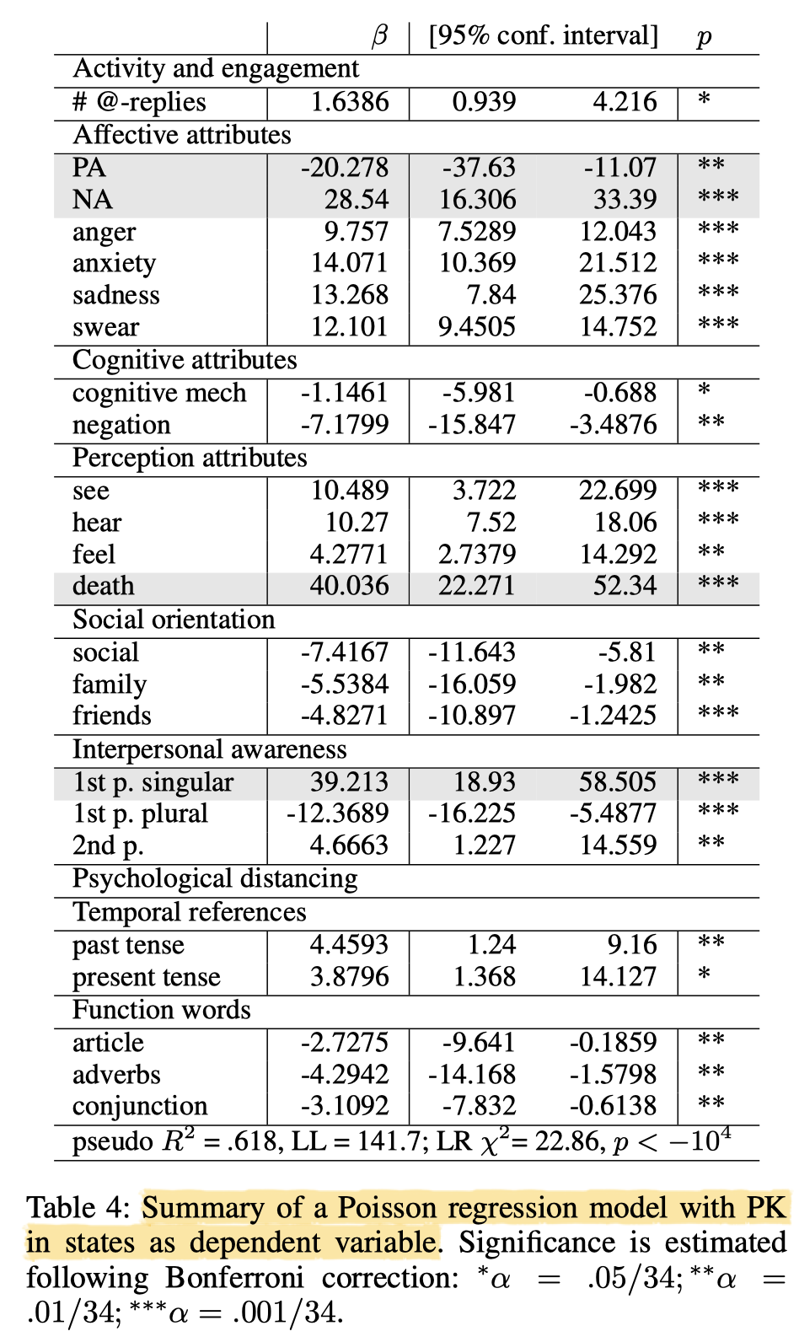
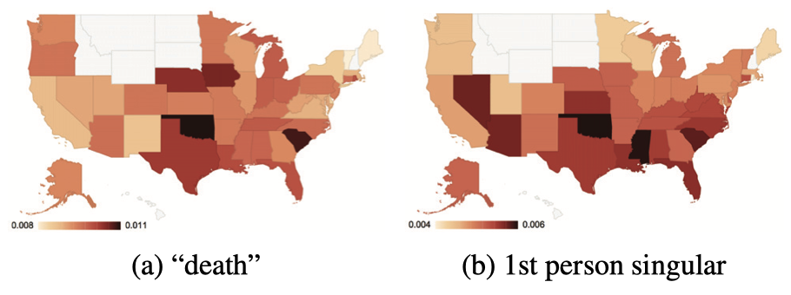
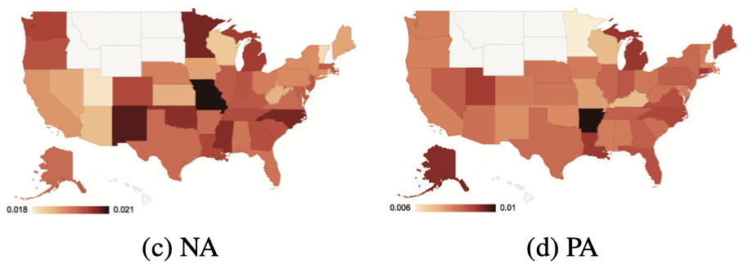
BLM OSM analysis
High PK states are associated with:
High negative reactions
Low social orientation
High psychological distance

Slide 38
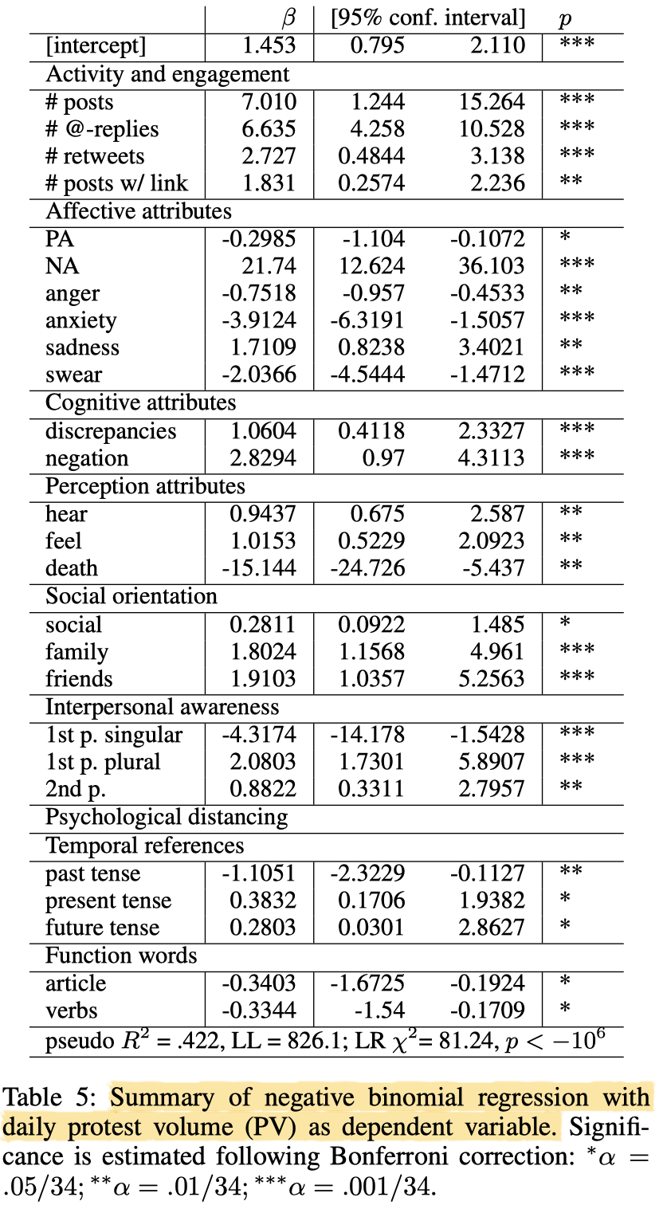
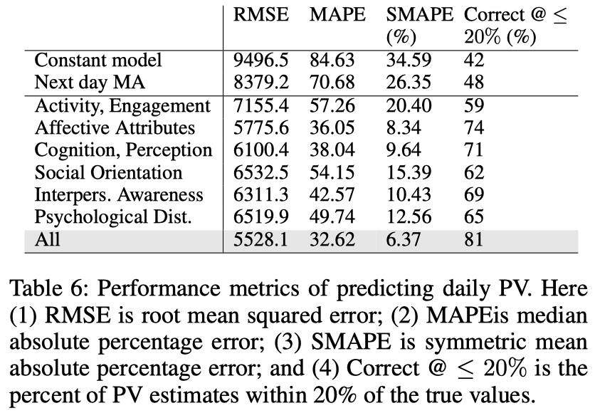
BLM OSM analysis
High PV states are associated with:
High level of engagement
High collective identities
More futuristic inclination

Slide 39
SMA in public health
Predicting personal attributes
Health surveillance and outbreak detection
Tracking disease outbreaks via posts (e.g., COVID-19 monitoring)
Mental health monitoring and intervention
Identify depression, suicide, loneliness, etc.
Health behavior and lifestyle
Public opinion of “mask wearing”
Track diet, exercise, fitness, smoking, substance use, etc.
Disaster management
Real-time event tracking
Hashtag analysis for aid coordination during natural disasters
Notes:
Map of outbreak mentions.
Disaster response map.

Slide 40
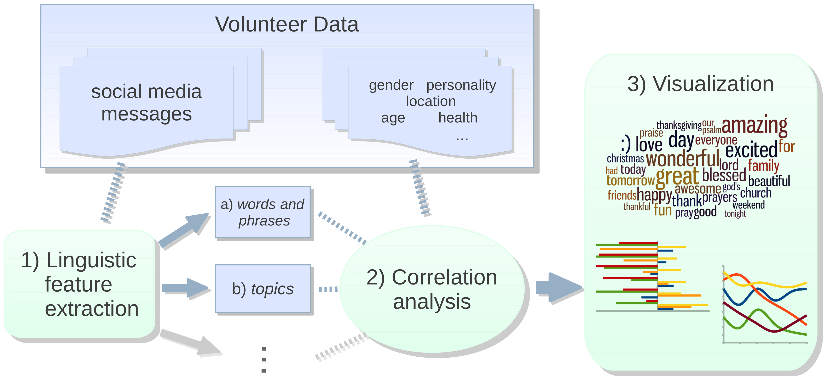
Predict demographic identities
Schwartz, H. A., Eichstaedt, J. C., Kern, M. L., Dziurzynski, L., Ramones, S. M., Agrawal, M., ... & Ungar, L. H. (2013). Personality, gender, and age in the language of social media: The open-vocabulary approach. PloS One, 8(9), e73791.

Slide 41
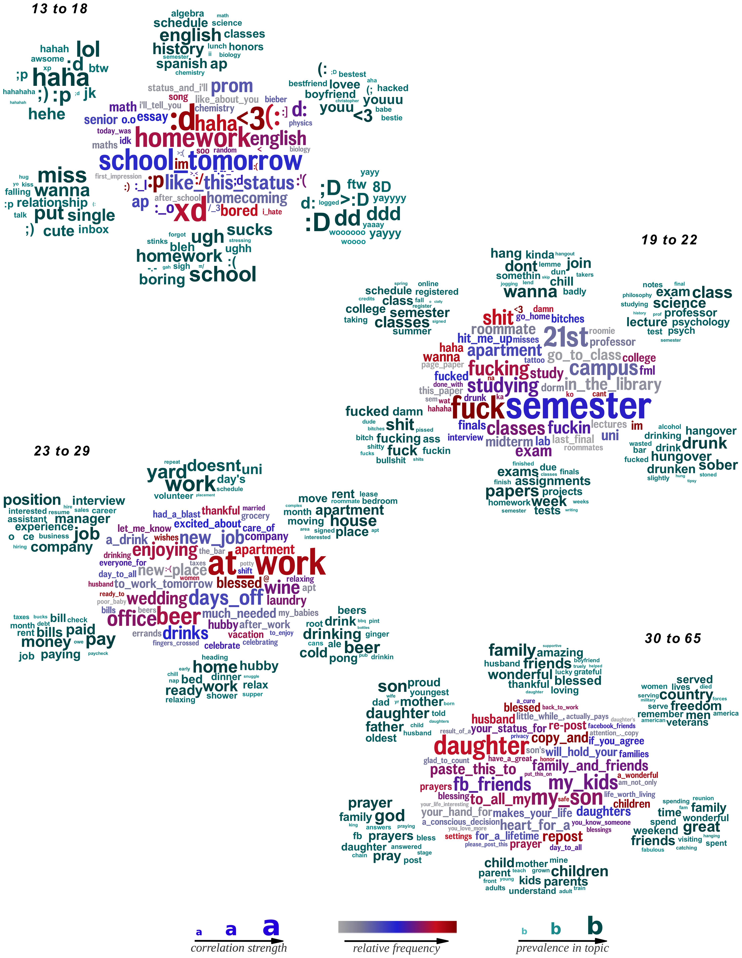
Our key topics change as we grow up
We will learn the LDA topic modeling later in the class.
No worry for now!

Slide 42
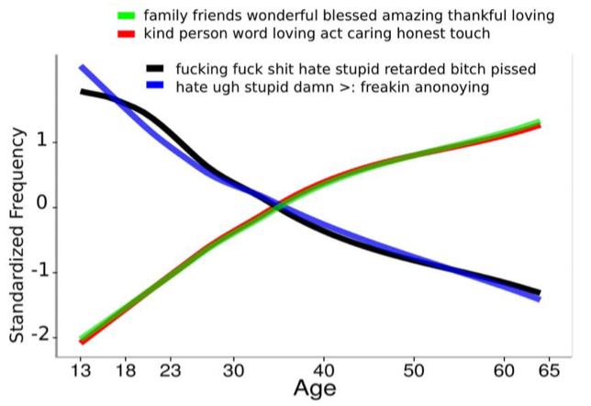
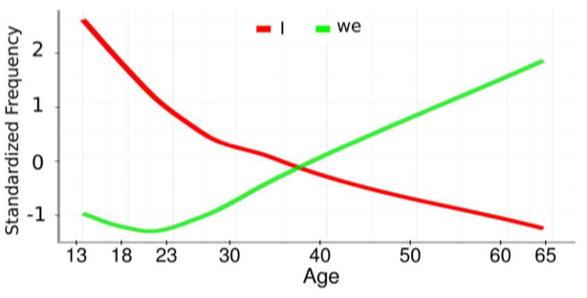
We become more positive as we age
Schwartz, H. A., Eichstaedt, J. C., Kern, M. L., Dziurzynski, L., Ramones, S. M., Agrawal, M., ... & Ungar, L. H. (2013). Personality, gender, and age in the language of social media: The open-vocabulary approach. PloS One, 8(9), e73791.
Notes:
Age is segmented into 4 groups (horizontal lines)

Slide 43
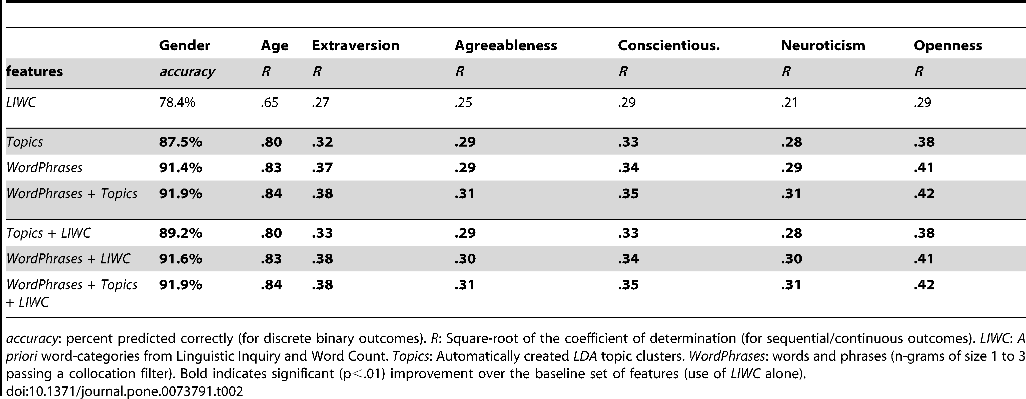
The power of language in predicting demographic and psychological traits
Especially accurate for predicting gender and age, less so for personality.

Slide 44
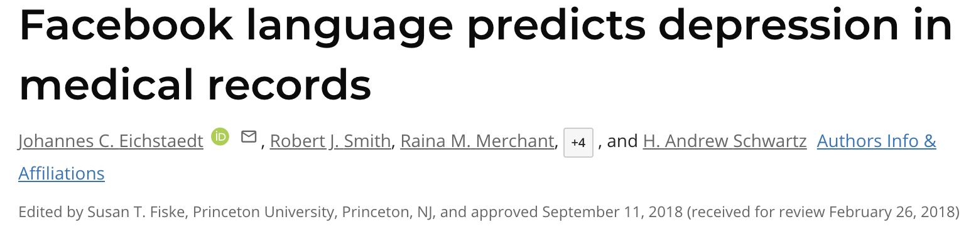
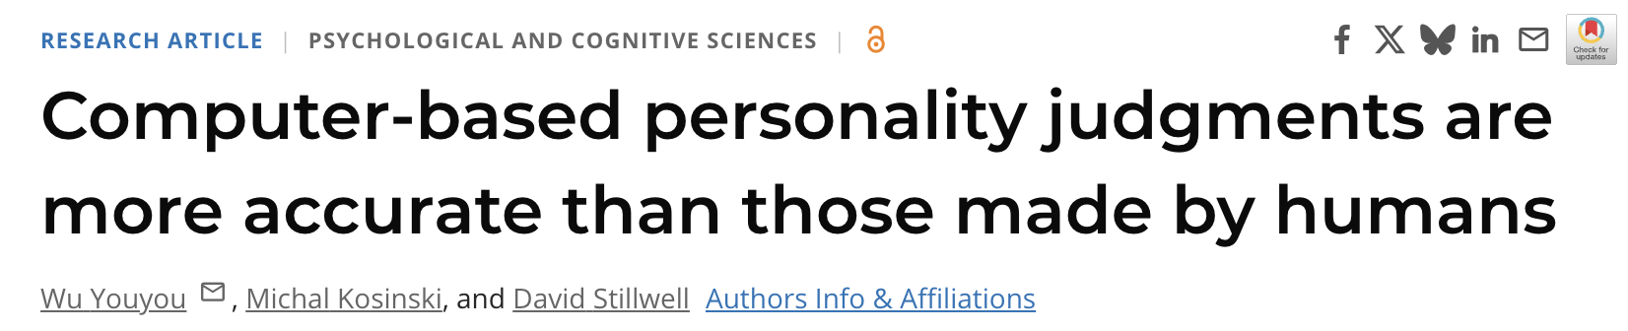
Predict mental health & psychology

Slide 45

Detect earthquake using Twitter

Slide 46
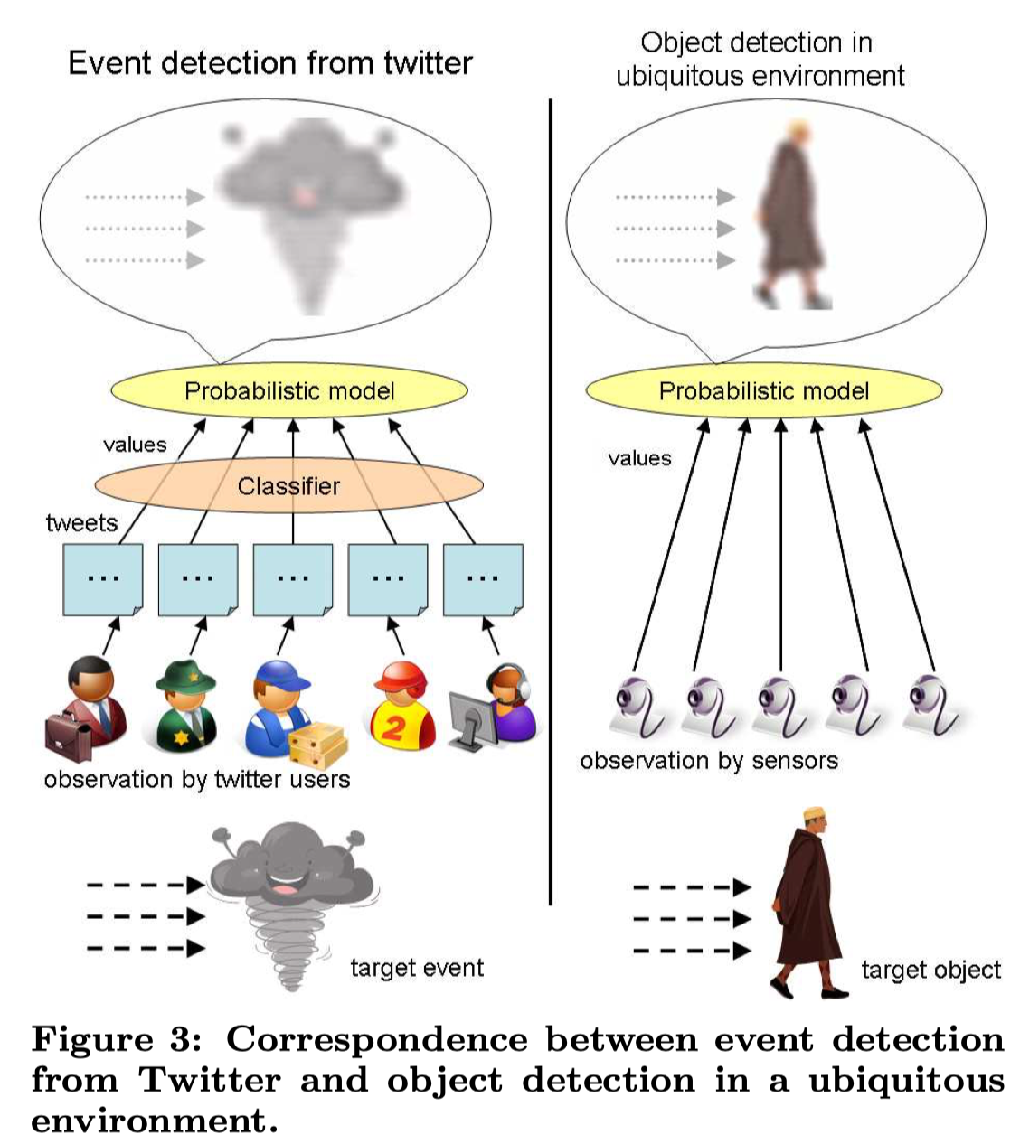
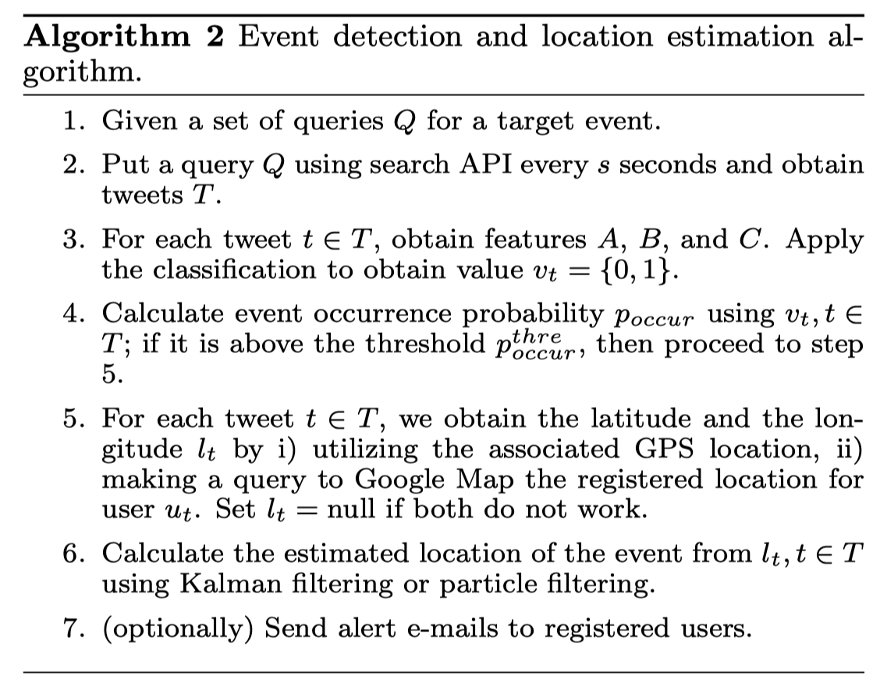
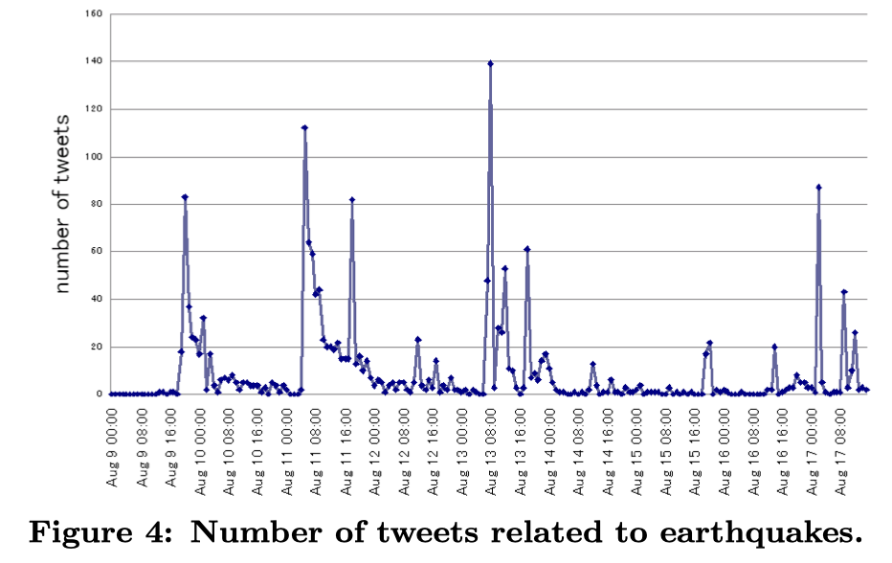
Detecting earthquake
Notes:
Sandy
Each candidate tweet shares some info. about its location. Voting to determine its precise location.

Slide 47
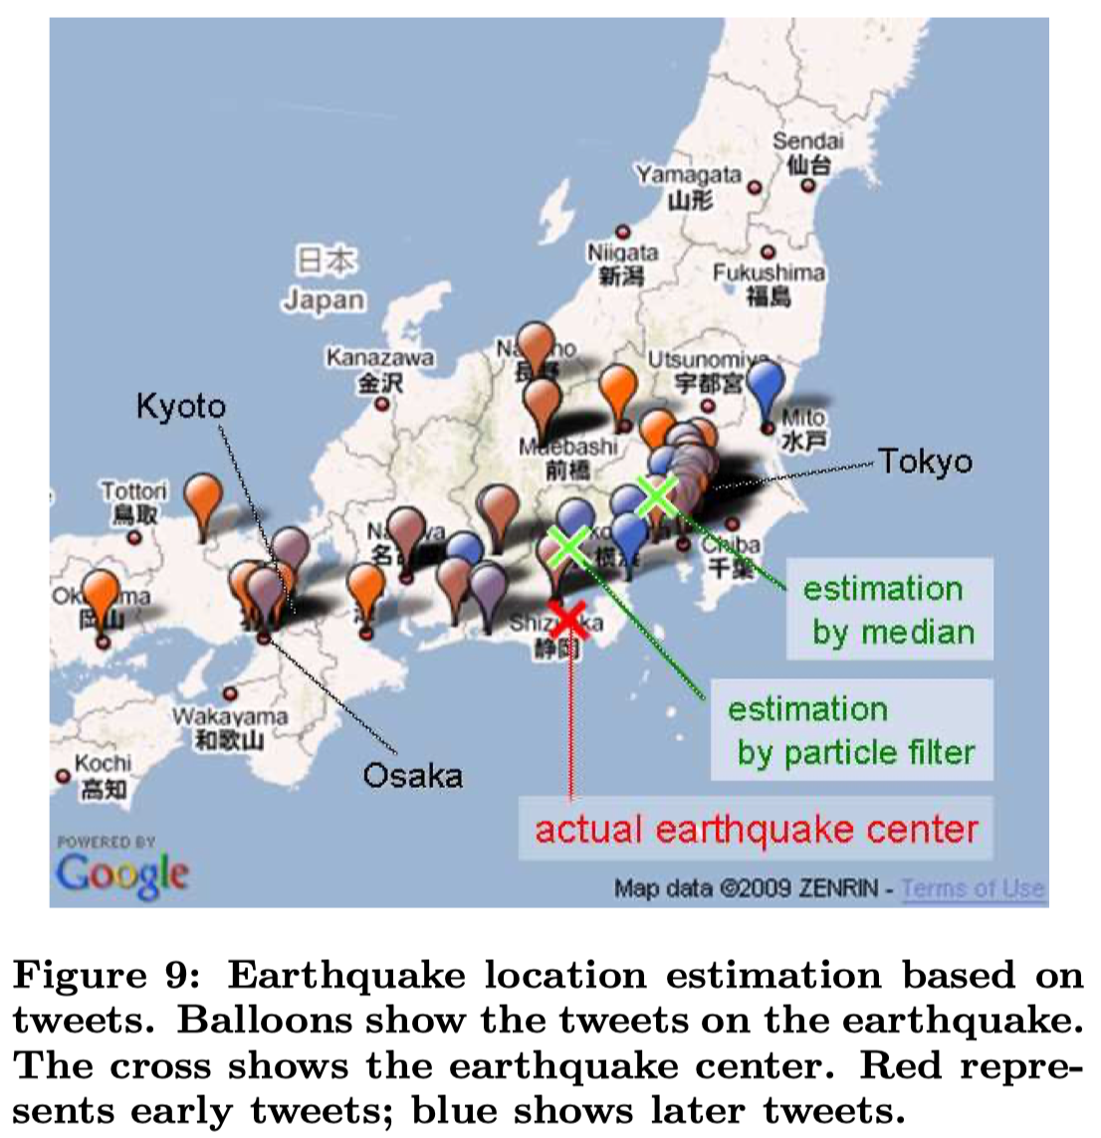
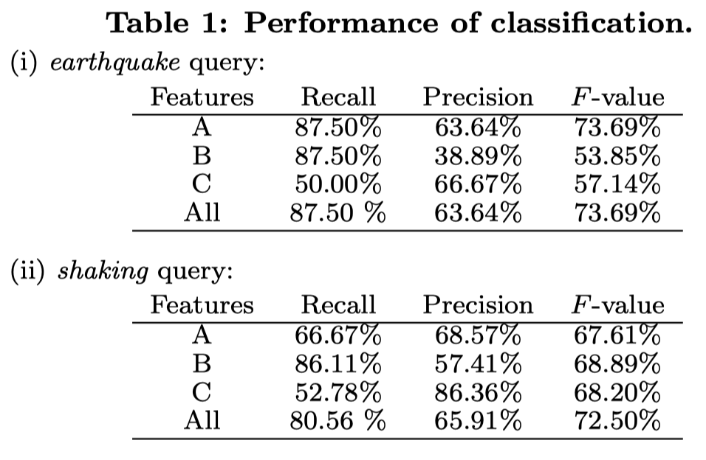
Detecting earthquake
Classify earthquake-related tweets using:
Semantic features (length, etc.)
Keywords features
Word context features
Hard case: “Is this an earthquake or a truck passing?”

Slide 48
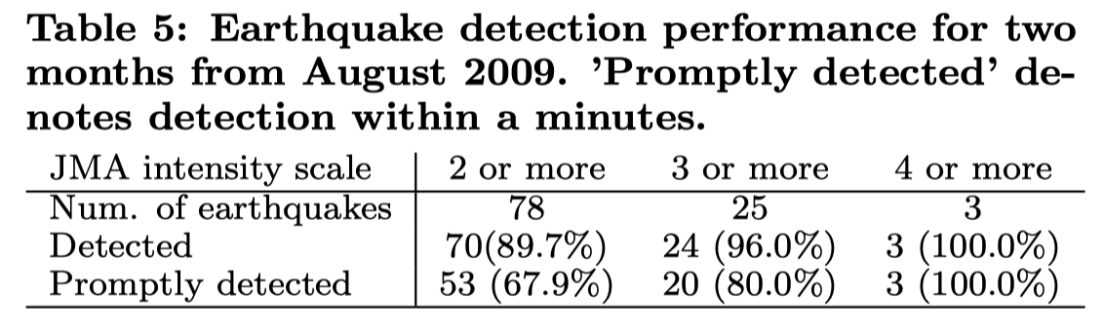
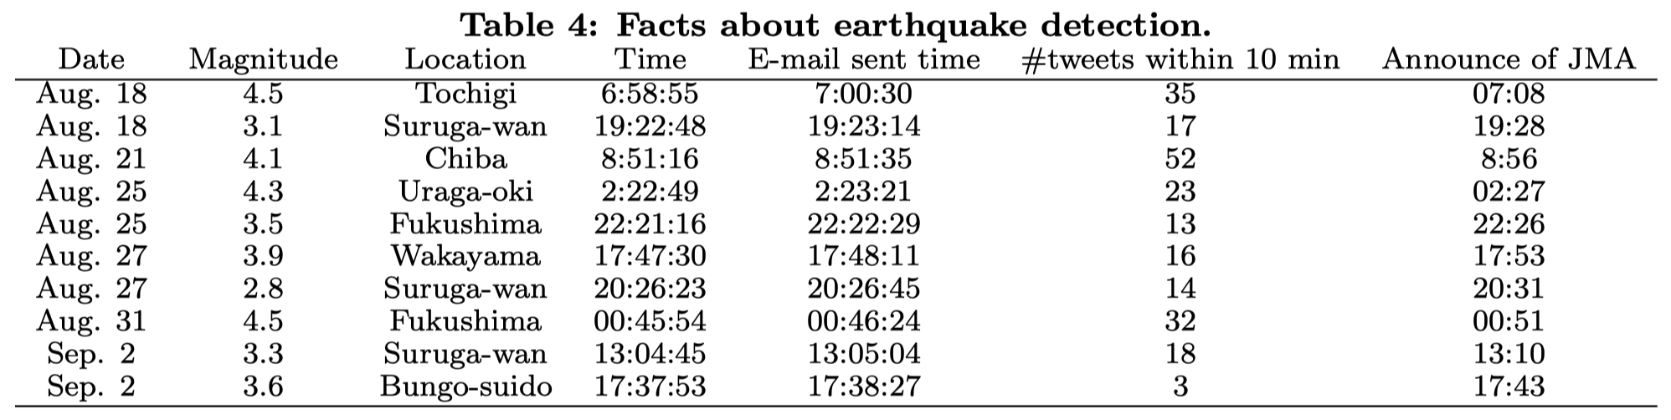
Detecting earthquake
Real-world performance is very good:
Can detect 96% earthquake with JMA seismic intensity scale +3
Recency close to 1 minute; better than JMA!

Slide 49

SMA for social media industry
Social media companies have the most interest in SMA:
User adoption & retention & engagement
Reduce misinformation / polarization / segregation
Target marketing
Personalization

Slide 50
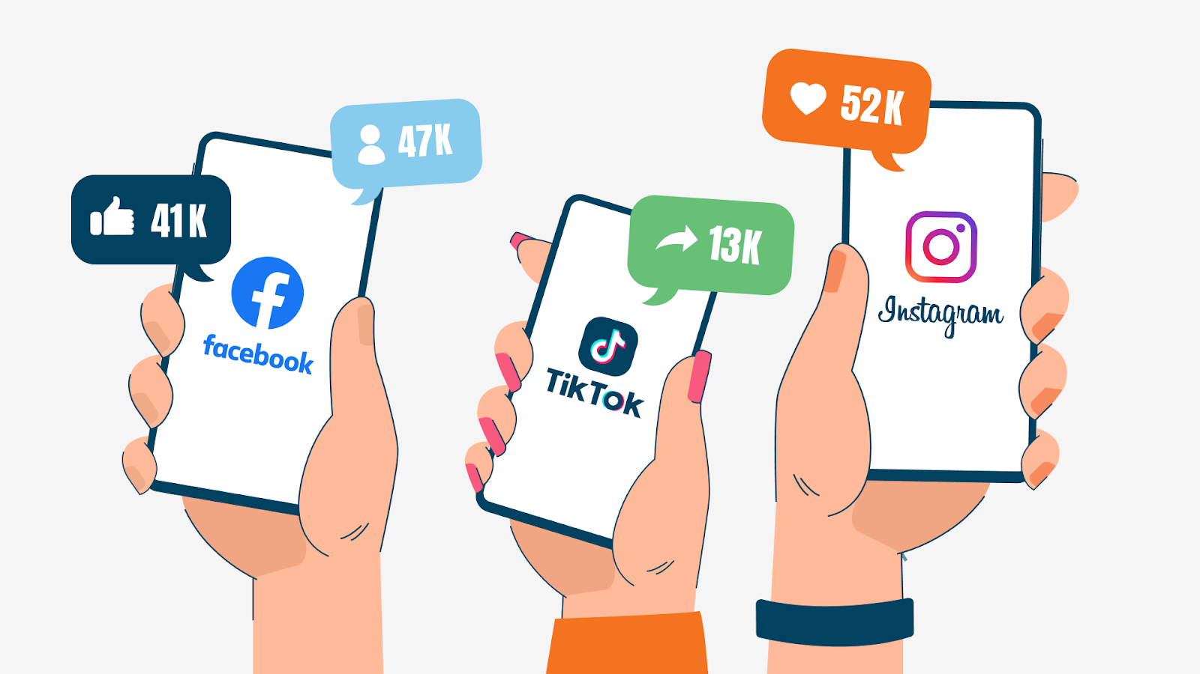
Key metrics in SMA
Reach: number of unique users who see the content
E.g., A post seen by 10,000 unique users
Impressions: total number of times a post was displayed
Same post can by viewed multiple times by the same person
Engagement: number of interactions
E.g., Likes, comments, shares
Engagement rate: (Engagements / Reach) * 100
Click-Through Rate: Clicks / Impressions
Notes:
Metric icons.

Slide 51
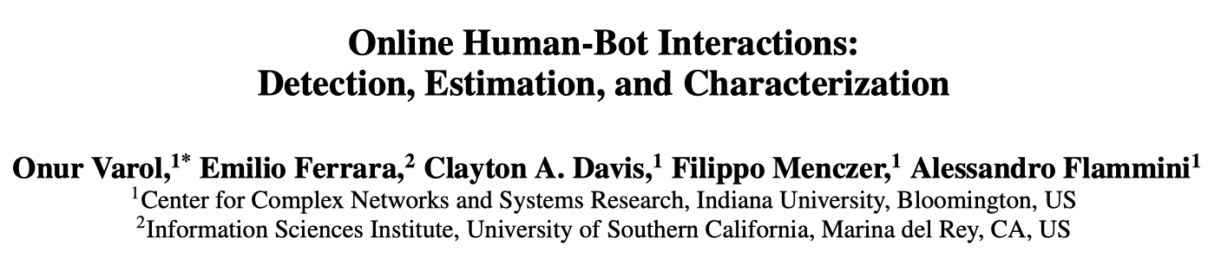
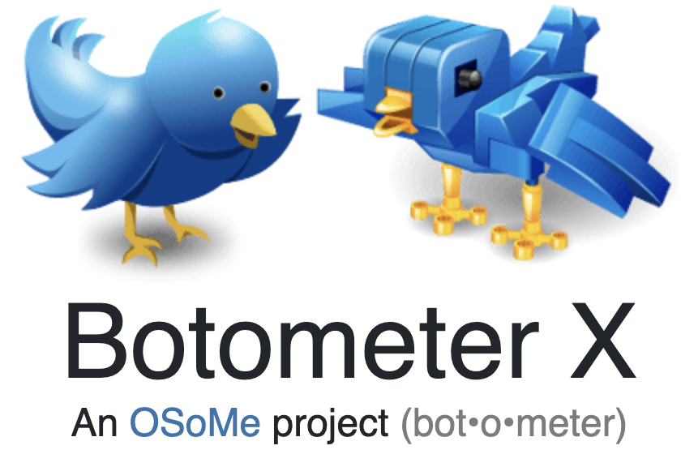
Bot detection (main goal of SM sites)
Social bots: SM accounts controlled by software
Amplifying misinformation
Swaying public attention
Suppressing speech
Spreading spam information
Trolling / attacking victims
Demo: https://botometer.osome.iu.edu/

Slide 52
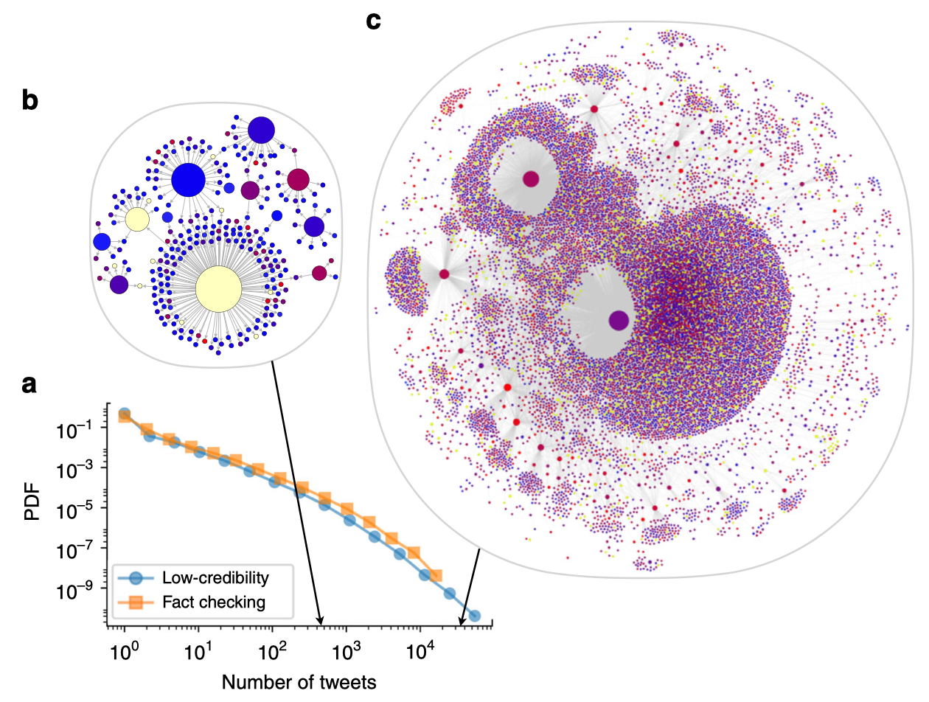
Spread of misinformation
Shao, C., Ciampaglia, G. L., Varol, O., Yang, K. C., Flammini, A., & Menczer, F. (2018). The spread of low-credibility content by social bots. Nature Communications, 9(1), 4787.
Notes:
We observe that the popularity distribution of low-credibility articles is almost indistinguishable from that of fact-checking articles, meaning that low-credibility content is equally or more likely to spread virally.
B and C are two fake articles of dramatically different virality. Nodes and links represent Twitter accounts and retweets of the article.
Node color represents bot score, from blue (likely human) to red (likely bot); yellow nodes cannot be evaluated because they have either been suspended or deleted.

Slide 53
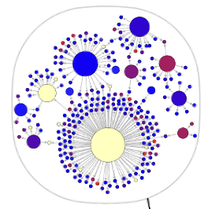
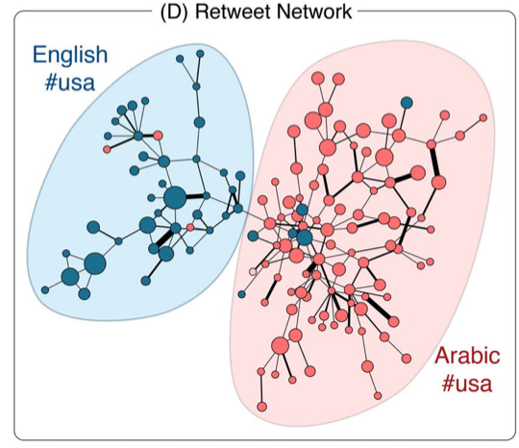
Spread of misinformation
Fake news vs. true news:
Similar popularity distribution (hard to tell apart just based on popularity)
Popularity is very heterogeneous across articles in both groups
False news is slightly even more viral
Fake news is largely driven by bots with no connections between them.
Can we utilize network structure of the retweeting network to detect fake news?
Notes:
Which one is a fake news?
Top is a fake news: Node color represents bot score, from blue (likely human) to red (likely bot); yellow nodes cannot be evaluated because they have either been suspended or deleted.
Bottom is a true news: Blue color means early adopter. Red means late adopter.

Slide 54
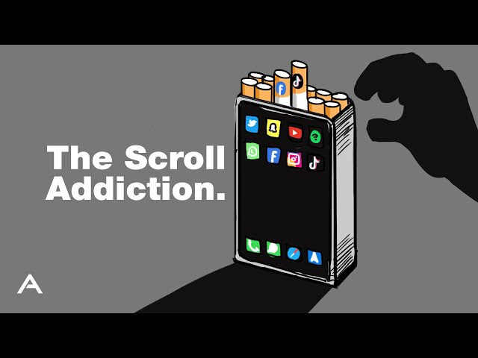
Discussion: Challenges in SMA
Privacy concerns (consent, anonymity)
Data bias / unrepresentative
Misinformation / bots
Proprietary algorithms
Decreasing well-being
Notes:
Icon-based visuals for each challenge.

Slide 55

Emerging technologies
Intelligent LLM agents
Replaces human moderators
Immersive technologies (VR/AR/MR)
Enables new forms of engagement, such as virtual events
Blockchain for data security
Enhancing data privacy and security in SMA
Ensuring ethical data collection and compliance with regulations
Addressing growing user concerns about data protection
Video analytics
Provides deeper insights into performance metrics, including engagement, watch time, and audience retention
Real-time analytics
Responds swiftly to trends or crises; enables proactive strategies

Slide 56
Getting prepared
Setup Python programming environment
Install Python
Install Jupyter Notebook for interactive coding
Install libraries: numpy, pandas, matplotlib, etc.
Practice time
Follow steps to setup computing tools
Consider using virtual environments
Ask questions to resolve issues now

